Slide 1
Session 7
NAD1001: INTRODUCTION TO ARCHITECTURAL DESIGN

Slide 3
Australian Standard on Technical Drawings
Read the Australian Standard on Technical Drawings
Then discuss around other documentation drawings will continue in week 2 and week 3…

Slide 4
Activity: Section 3 - Lines

Slide 5
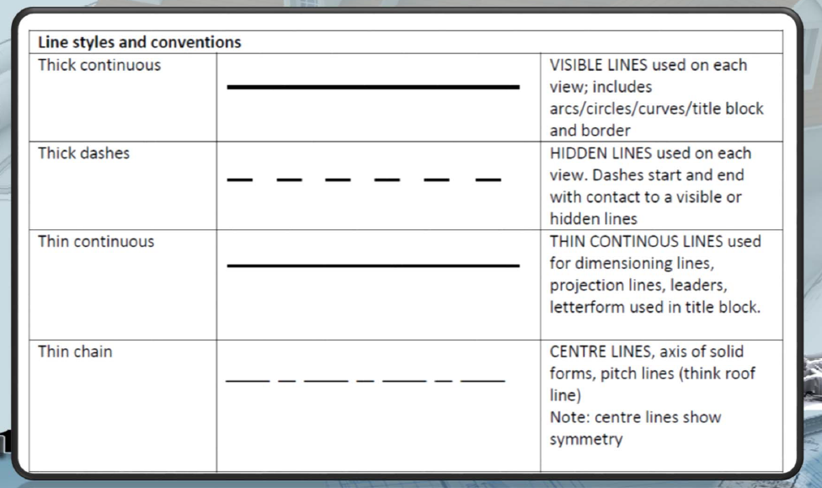
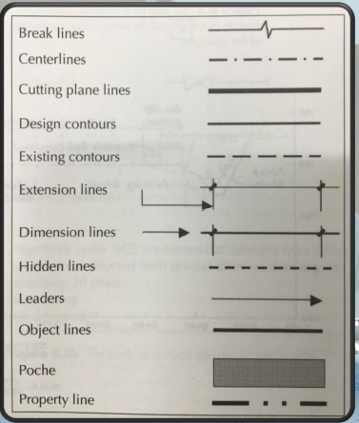
Line Styles and Conventions – the Basics

Slide 6
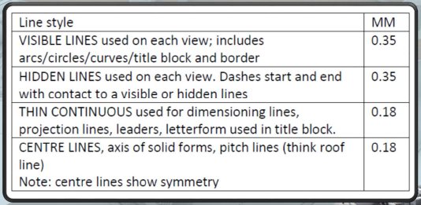
Line Styles and Conventions – the Basics

Slide 7
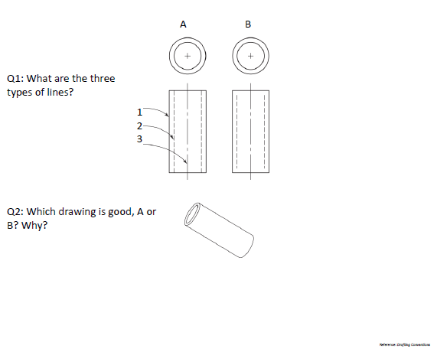
Pick a Drawing- Question

Slide 8
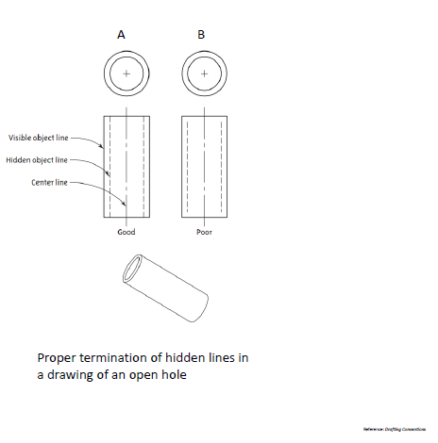
Pick a Drawing – Answer

Slide 9
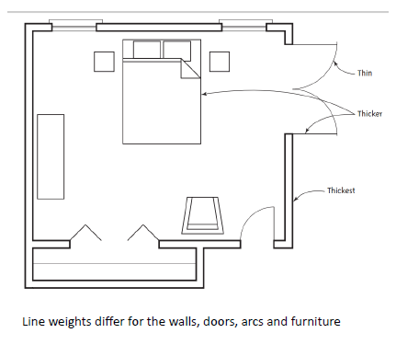
Drawing Sample – Based on the Line Weights and Types

Slide 10
Activity: Section 4 - Letters, Numerals and Symbols

Slide 11
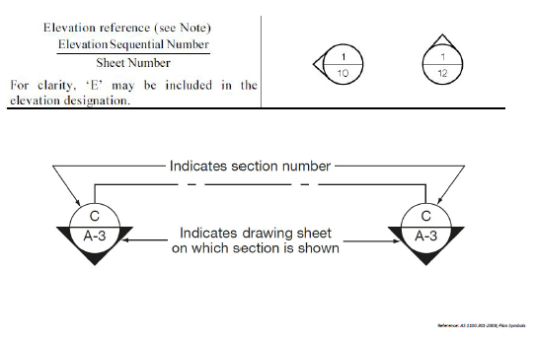
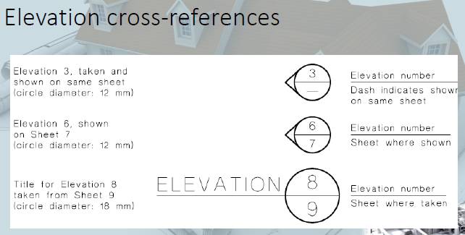
Symbols

Slide 12
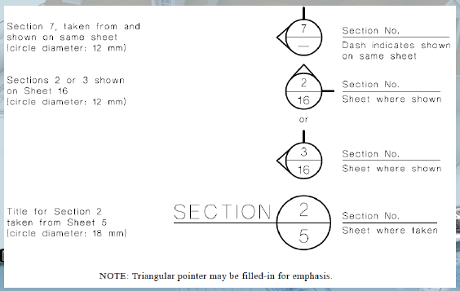
Section Cross-Reference

Slide 13
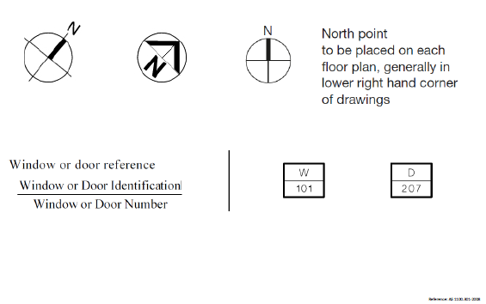
Symbols

Slide 14
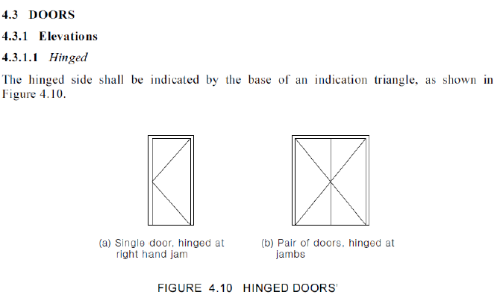
Doors

Slide 15
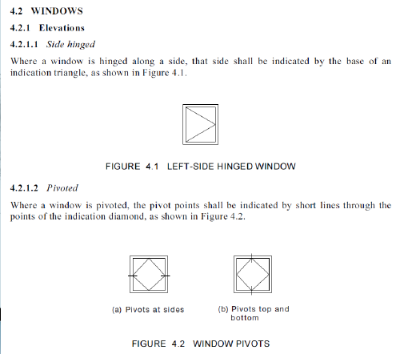
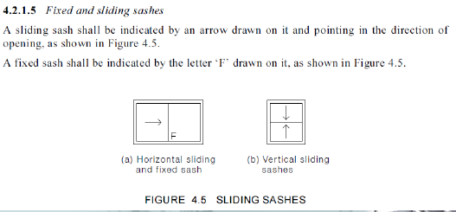
Windows

Slide 16
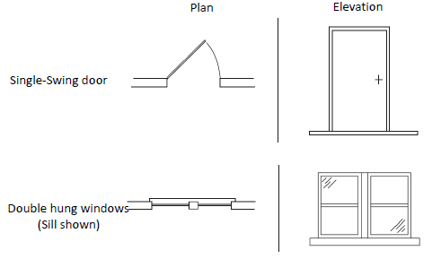
Plan and Elevation View

Slide 17
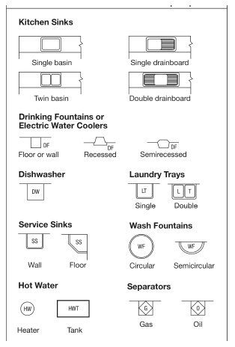
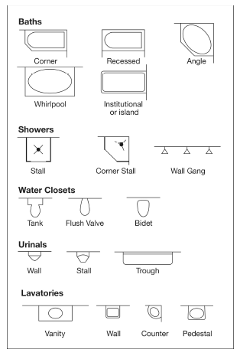
Other Symbols

Slide 18
Activity: Section 5 - Scales

Slide 19
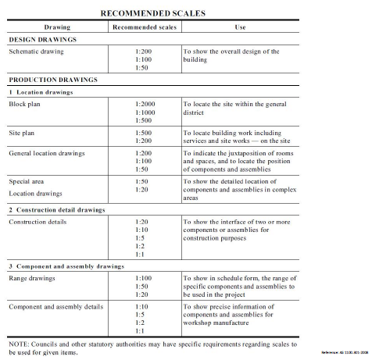
Answer to Activity
Source: Australian Standard 1100.101-1992 Technical drawing

Slide 20
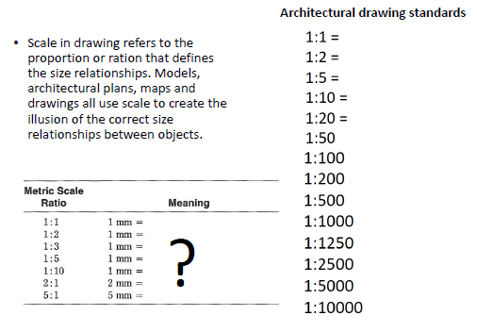
Scale

Slide 21
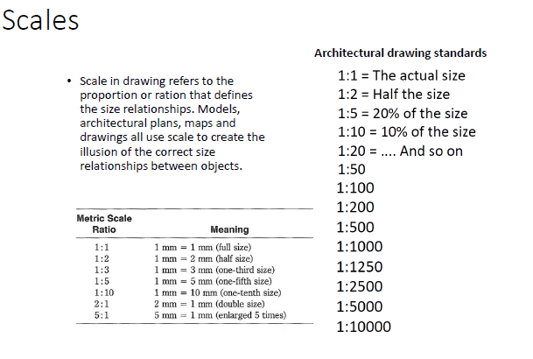

Slide 22
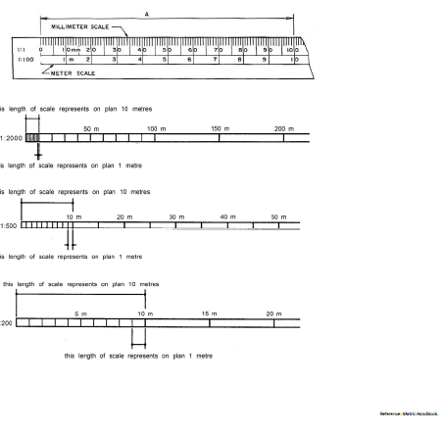
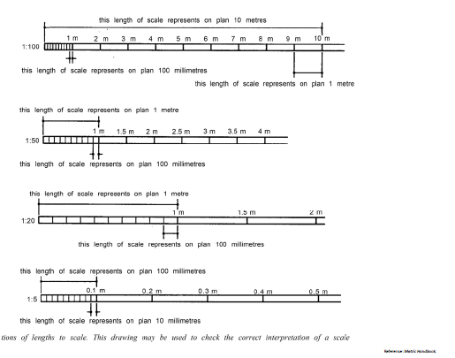
Scale Convention

Slide 23
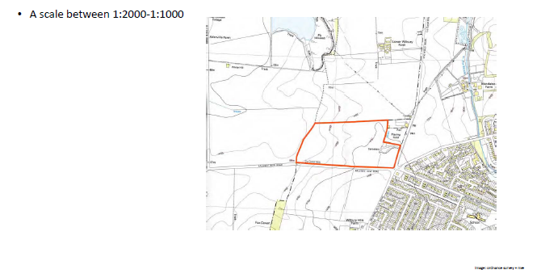
Scale Example

Slide 24
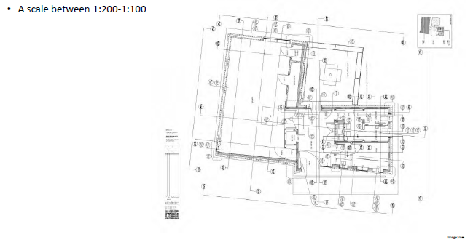
Scale Example

Slide 25
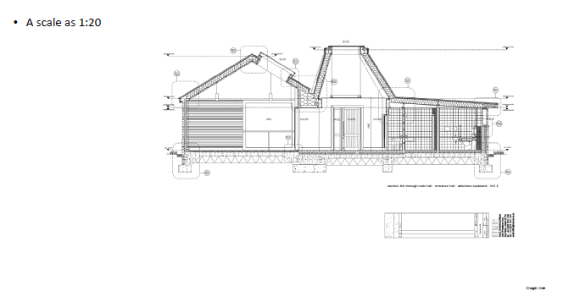
Scale Example

Slide 26
Activity: Section 5 - Sections

Slide 27
Activity: Section 8 - Dimensioning

Slide 28
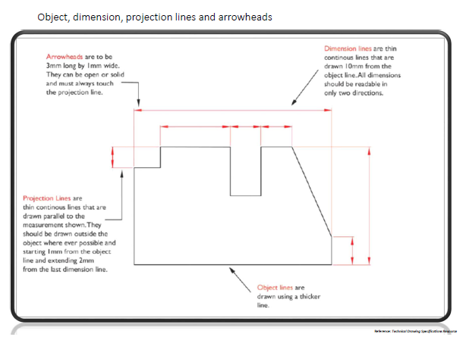
Dimension Example

Slide 29
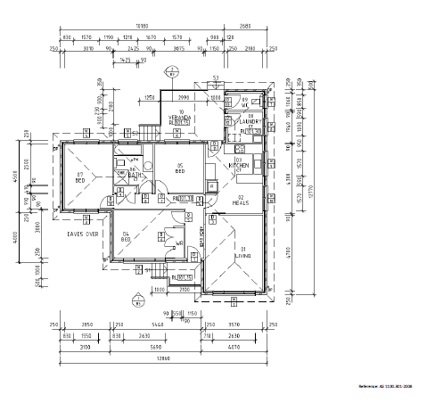
Dimension Example

Slide 30
Session 7
Details

Slide 31
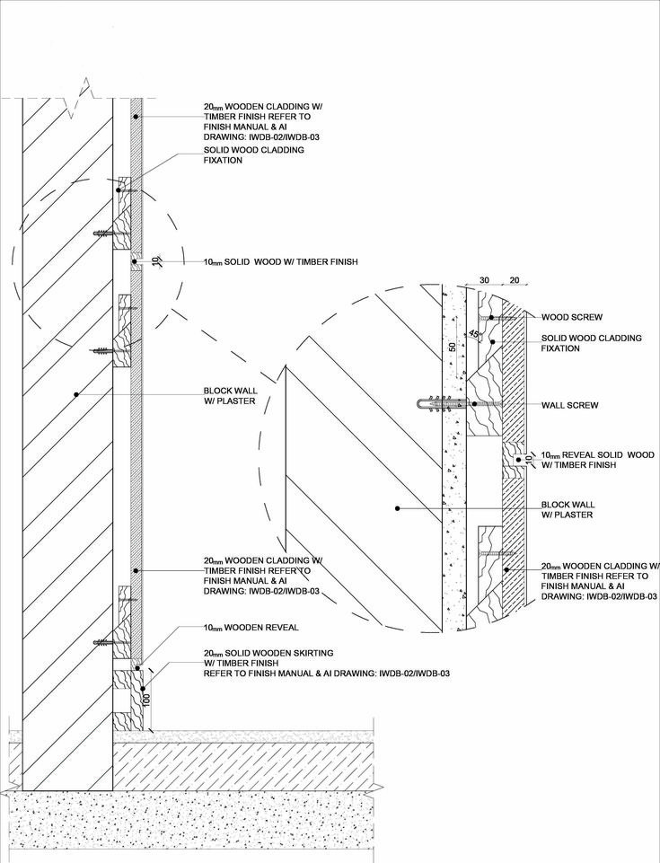
Architectural Detail
Architectural details are enlarged drawings of specific architectural assemblies.
Architects need to produce these drawings as a part of the documentation set too.
Detail drawings are produced after other design drawings towards the end of the design process.

Slide 32
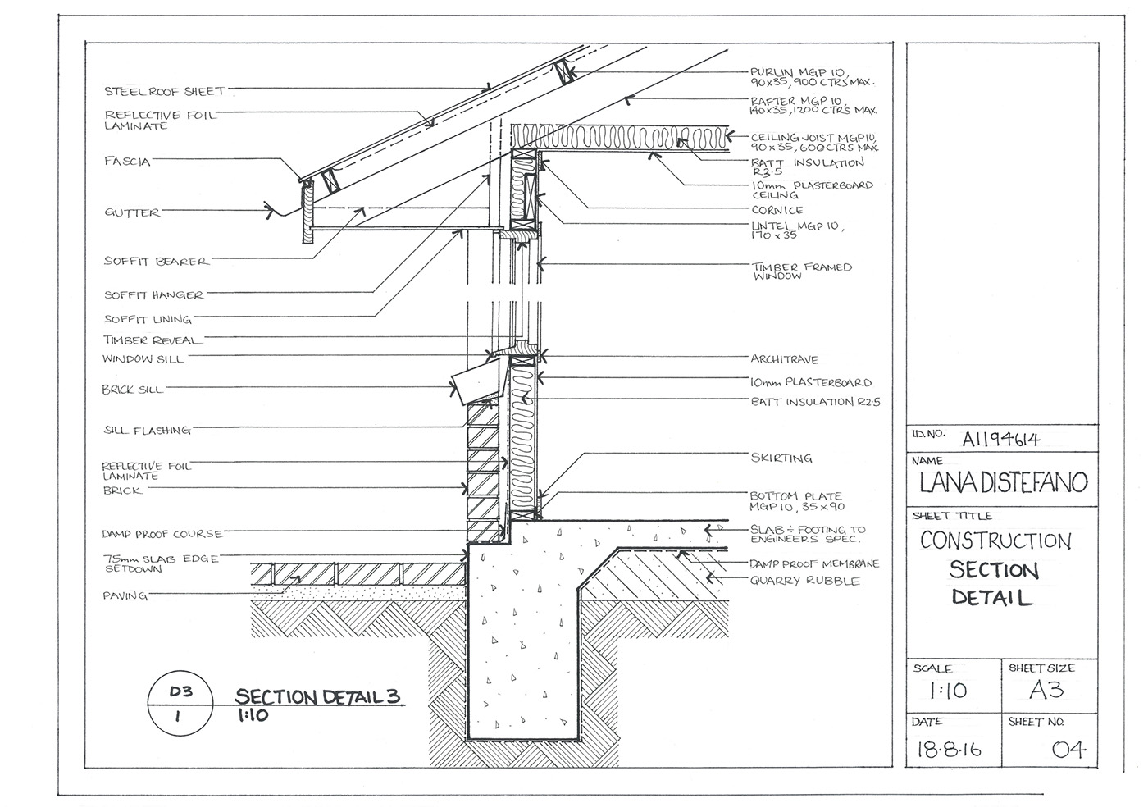
Details
When is an architectural detail needed?
What are the purposes of drawing details?
How to decide the number of details?
Source: Pinterest

Slide 33
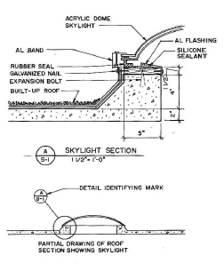
Detail Identification
Details are identified by a mark which gives them a deification number or letter and indicates the sheet upon which they are drawn

Slide 34
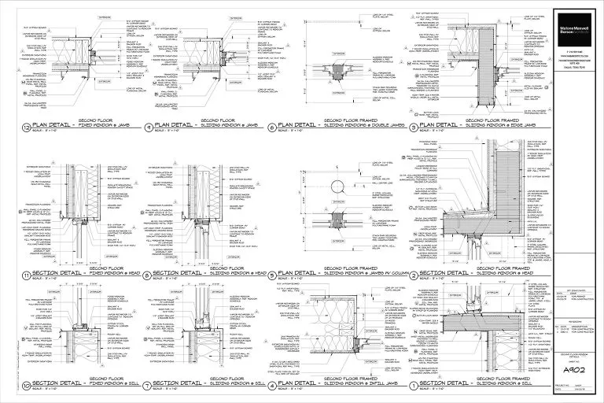
Other Requirements
On the sheet with other drawing：Draw details that pertain directly
On independent sheets： Whenever possible, get all drawings that are related together on one sheet
Make sure to include scale, dimensioning, notes and label

Slide 35
Activity: Design Development

Slide 36
References
Australian Standards. (2021). AS 1100.101-1992 Technical Drawing. https://www.saiglobal.com/PDFTemp/Previews/OSH/As/as1000/1100/1100101.pdf
Pinterest. (2025). Pinterest Image. https://www.pinterest.com/

Slide 37
Thank you
Questions?

